Slide 1
Exercise A
The Henry Problem
Notes:
SEAWAT Training Course
Lecture 7

Slide 2
Henry Problem Description
Mixing by diffusion (i.e. no mechanical dispersion)
impermeable boundary
freshwater influx
seawater hydrostatic
100 cm
impermeable boundary
200 cm

Slide 3
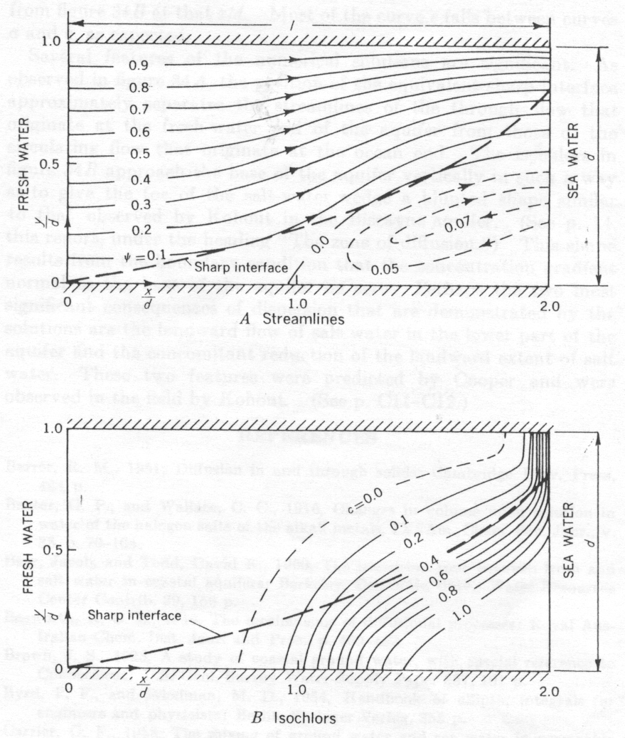
Henry’s Original Solution

Slide 4
Henry Solution Used to Benchmark Codes
Pinder and Cooper (1970)
Lee and Cheng (1974)
Segol et al. (1975)
Huyakorn and Taylor (1976)
Desai and Contractor (1977)
Frind (1982)

Slide 5
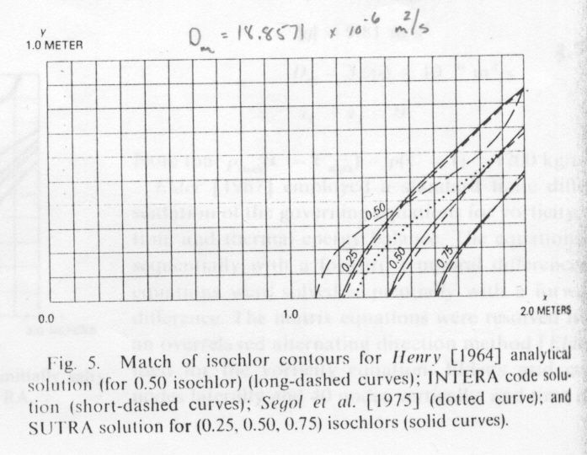
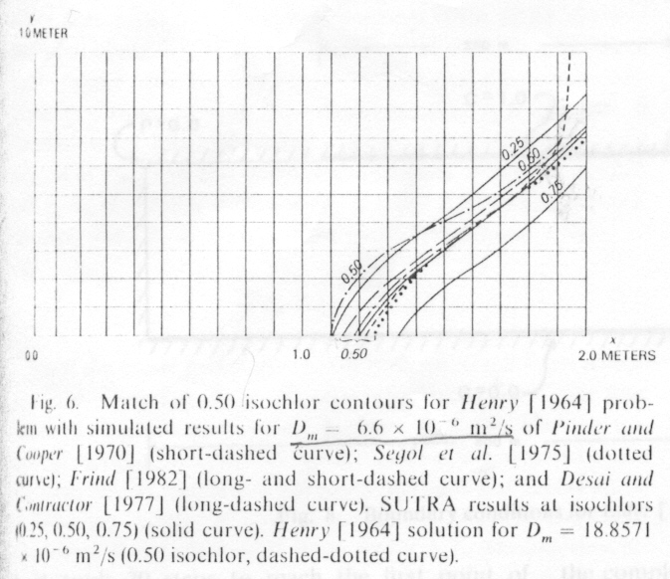
Voss and Souza (1987)
Showed that dispersion used to test codes was not the same as Henry’s value
Henry
Henry

Slide 6
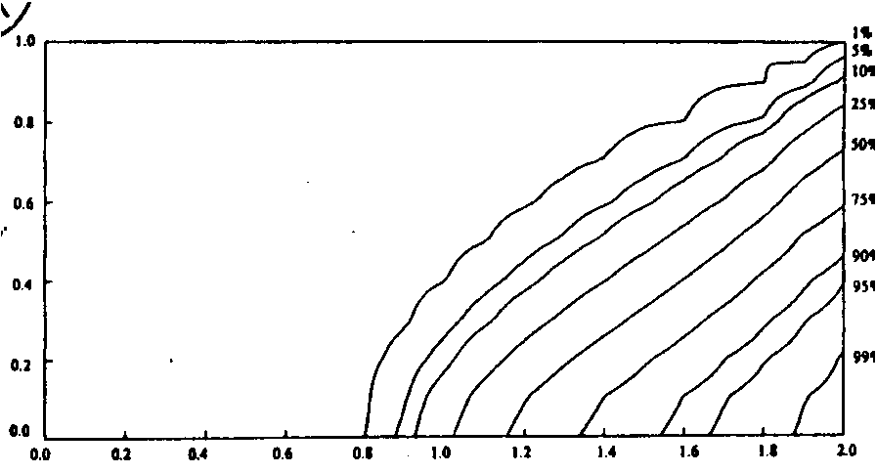
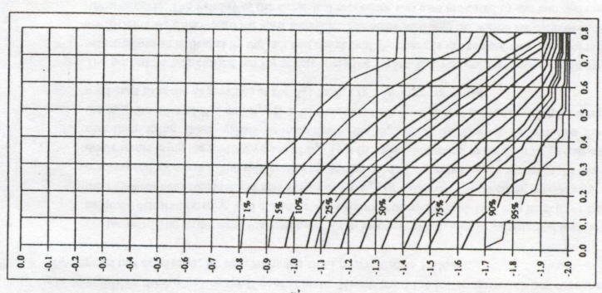
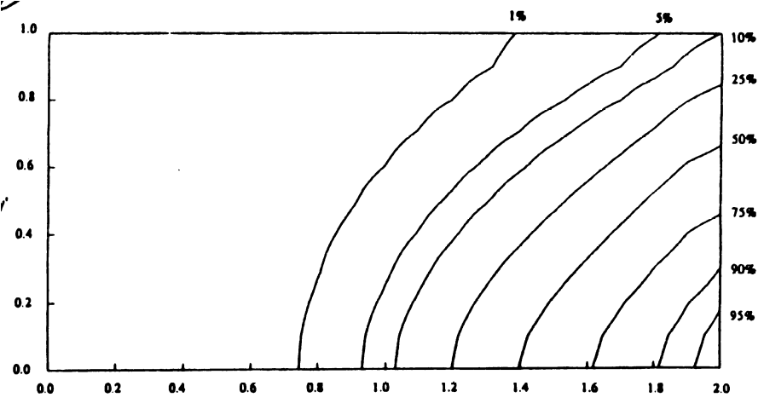
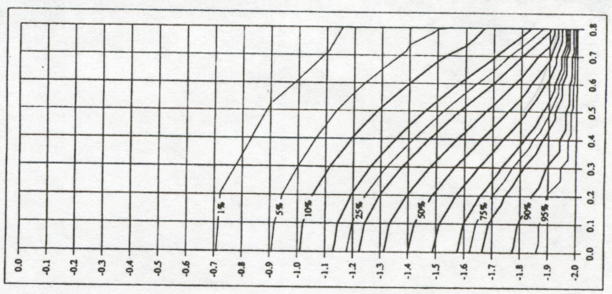
Segol (1994)
Sutra results
Revised Henry solution

Slide 7
Simpson and Clement (2004)
Recalculated solution to Henry’s problem using semianalytical method
Matched revised solution exactly with finite-element model
Proposed modified Henry problem (with ½ flow rate) as better test for variable density models

Slide 8
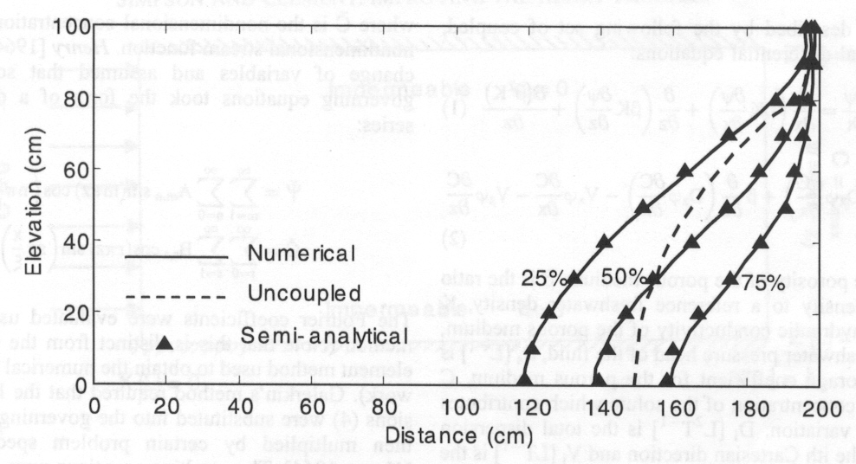
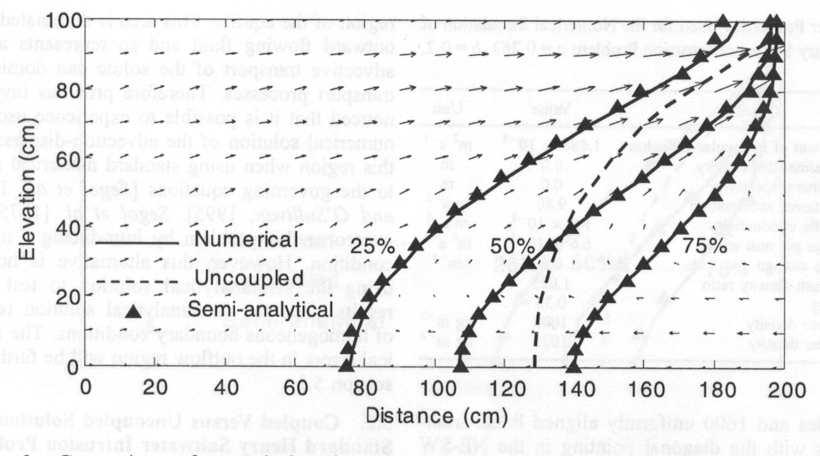
Simpson and Clement (2004)
Original Henry problem
Modified Henry problem

Slide 9
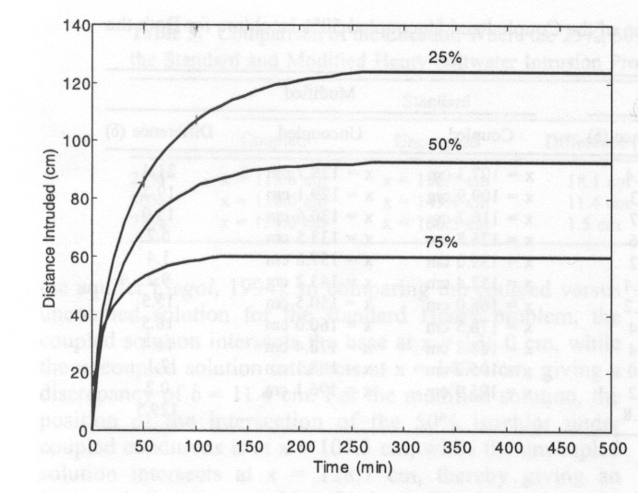
Simpson and Clement (2004)

Slide 10
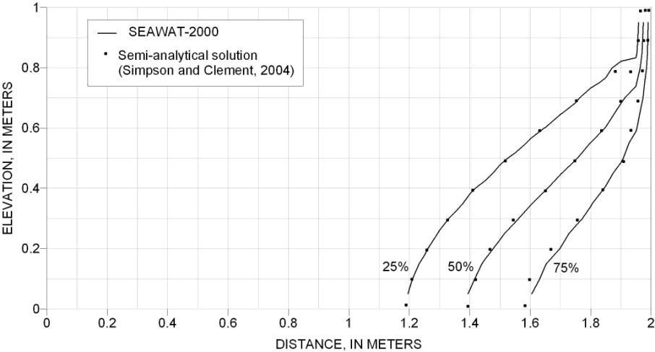
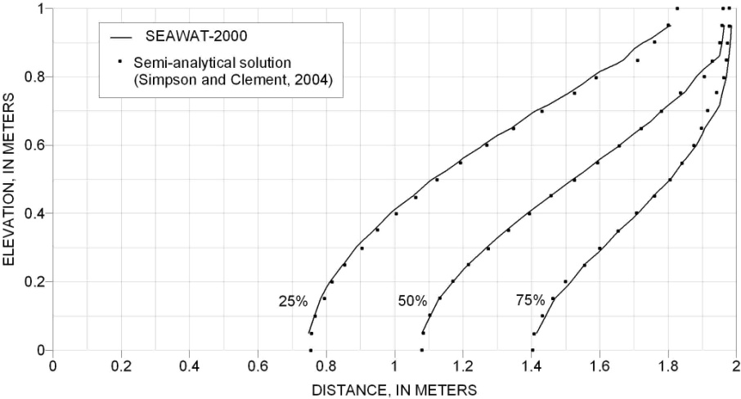
SEAWAT Results
Henry
Modified Henry
Note: right solute boundary specified with constant seawater concentration (ITYPE = -1 in MT3DMS SSM Package)

Slide 11
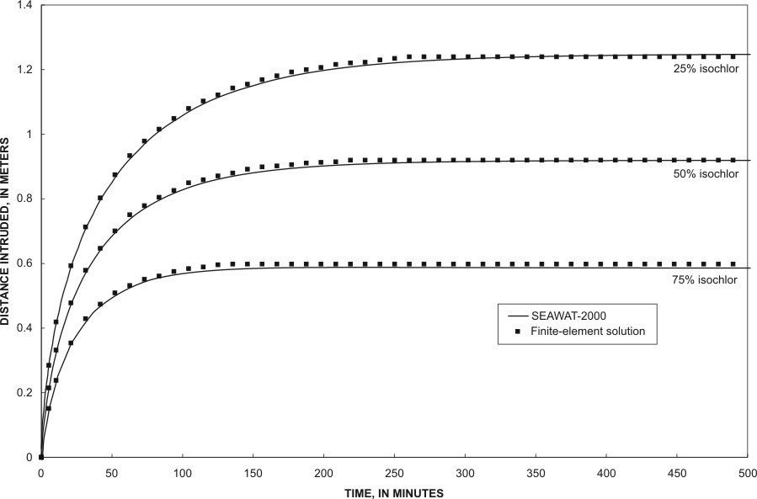
SEAWAT Results

Slide 12
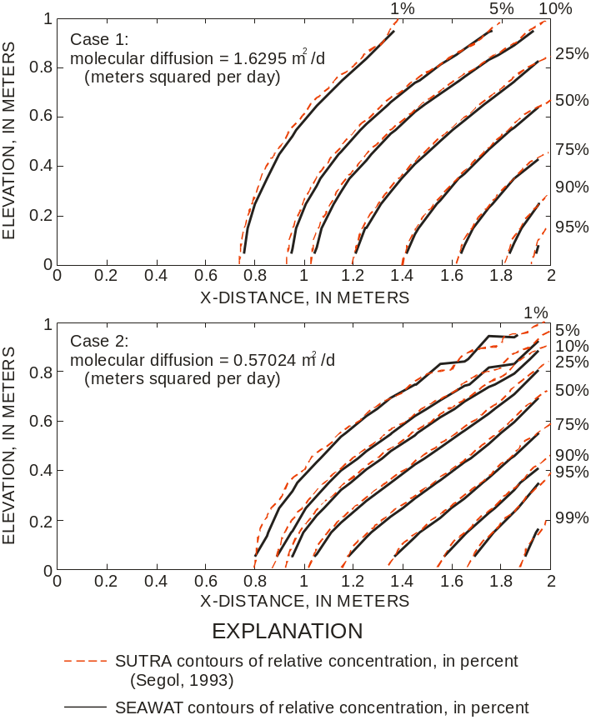
SEAWAT and SUTRA Results
Note: dispersive solute flux not allowed across seawater boundary (ITYPE = 1 in MT3DMS SSM Package)

